Slide 1
Europe and Post-Europe. On Jan Patočka’s Philosophy of History

Slide 2
Jan Patočka (1907-1977)
― Czech phenomenologist
― pupil of Husserl & Heidegger, friend of Eugen Fink
― spokesman for the Charta ’77
major contributions to ― phenomenology (interpreter & critic of Husserl, Heidegger)
― ancient Greek philosophy
― philosophy of history
― history of Czech philosophy
mostly banned from teaching
Belated reception: between 1976‒’92 11 works translated into French
1987‒’92 5 volumes translated into German
1989 Selected Writings appeared in English
1996‒2002 4 volumes translated into English

Slide 3
Heretical Essays in the Philosophy of History (1975)
Content
First Essay: Reflections on Prehistory
Second Essay: The Beginning of History
Third Essay: Does History Have a Meaning?
Fourth Essay: Europe and the European Heritage until the End of the 19th Century
Fifth Essay: Is Technological Civilization Decadent, and Why?
Sixth Essay: Wars of the Twentieth Century and the Twentieth Century as War
‒‒‒‒‒‒‒‒‒‒‒‒‒‒‒‒‒‒‒‒‒‒‒‒‒‒‒‒‒‒‒‒‒‒‒‒‒‒‒‒‒‒‒‒‒‒‒‒‒‒‒‒‒‒‒‒‒
Σ: reflections on ― the essence of Europe & its historical unfolding
― its broken legacy & the essence of the post-European era
in order to ― find a tenable spiritual foundation for it
― to avoid dissolution of its humanity
‘External’ history illuminated by an ‘internal-originary’ history of the soul,
the basic constellations of our inmost relation to ourselves

Slide 4
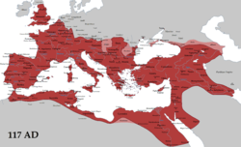
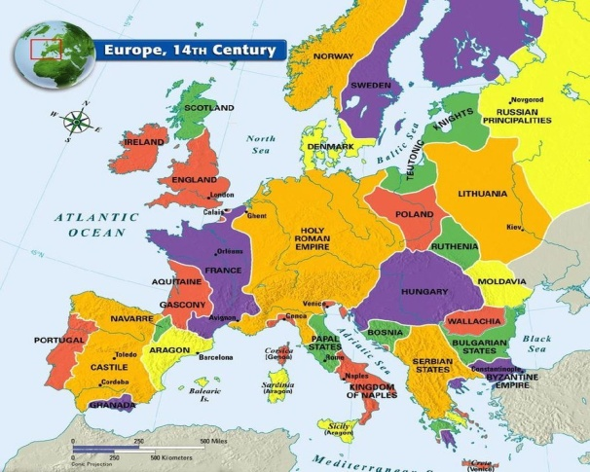
The History of Europe – Unification and Particularization
Turning Point
27 BC 476 AD 800 16th c.│ 1806
↓ ↓ ↓
Napoleonic ↓ wars ↓ ↓
↓ ↓
European
particularism
↓
↓ European ‘unification’
Greek city-states
Roman Republic
Roman Empire
Holy Roman Empire

Slide 5
The European Heritage: Care for the Soul
1095-1291
5th c. BC 27 BC 476 AD 800 7 major Crusades 1806 Today
Greece & Rom. Republic
Roman Empire
Holy Roman Empire
core of Rome: idea of empire
‒ state free of ethnic/territorial foundation
‒ universal rule of law
Republic ‒ essentially a polis (Aristotle)
Stoicism: transformed Platonism into
educational instrument of the univ. state
→ the Roman Empire carried on the
heritage of Greek polis
religion as fundament of statehood
Western version of the idea of holy empire
duality of spiritual & secular power & supremacy of former
Ʃ: spiritual origins: historical theology (Epistles)
= the heritage of the Roman Empire
Idea of the Holy Roman Empire attests to the
1) failure of Stoic-Platonic cultivation
2) its persistence in a new form:
Ʃ: ‘city’ based on a truth of the other world
Polis: “striving for a community based on perceived truth and justice”
“care for the soul makes humans truthful and just”
“a lifelong inquiry, self-control, self-unifying intellectual and vital practice” (p. 81-82)

Slide 6
Transformation of the Principles of European Life
Turning point: 16th century
‒ westward expansion – scramble for riches
‒ Christian practice turns to the secular
‒ knowledge as power (Bacon)
‒ state: armed institution securing property
‒ capitalist organization of economy
Ʃ: “the primacy of having over being
excludes unity and universality
while the attempts to replace
them with power prove vain” (84)
care for the soul, care to be
↓
care to have, care for external
world and its conquest

Slide 7
Transformation of the Principles of European Life
New Political System & 18th century Enlightenment
‒ France takes over → Holy Empire pushed from the center
New England: a new human order + pressure from Russia
Enlightenment: old Europe’s adaptation to emerging economic order
― France & US takes the lead
‒ modernity: fundamentally revolutionary
― French Enlightenment tears down spiritual authorities
‒ alliance of industry, technology, and the capital order
→ technical revolution
‒ creation of immense technological-military superiority
‒ global market serves European physical power

Slide 8
Particularism of the 19th Century
1803-15 1914-18 1939-45 1950 Today
Napoleonic Particularism WWI WWII European Crisis
wars nationalisms ‘unification’ of EU
↓ ↓
spread ↓
revolutionary ↓
spirit ↓
nation state serving
bourgeois capitalism
→ nationalistic movements
‒ universalism only in emerging socialism
Prussian Germany: growing industrial production → reinforced proletariat
→ extreme social tension ↔ overcame by mobilizing = a chief root of WWI
(Halévy)

Slide 9
the Outburst of Force
1803-15 1914-18 1939-45 1950 Today
Napoleonic Particularism WWI WWII European Crisis
wars nationalisms ↓ ‘unification’ of EU
“The shared idea in the background of the first world war was … that there is nothing such as a factual, objective meaning of the world and of things, and that it is up to strength and power to create such meaning” /121
an “immense event … transcending humankind―a process in some sense cosmic” /119
“breakthrough of the conception of being that was born in the sixteenth century” /124
outburst of sheer Force
conflict being “the great instrument which … Force used in its transition from potency to actuality” /124-25

